Slide 1
Qualifying Random Walks of Polymers
Zachary Warnick

Slide 2
Random Walk
Movement of a polymer in time
One monomer added per unit time
Prohibited from backtracking
Intersection considered failure

Slide 3
Software Representation
A matrix of arbitrary size
Large enough to not inhibit movement
The monomer will be a 1, empty space a 0

Slide 4
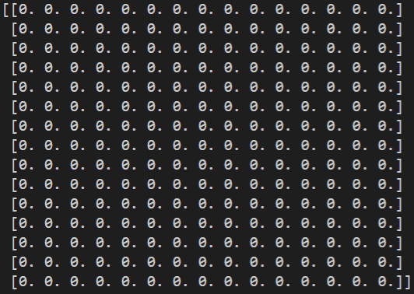
Software Representation

Slide 5
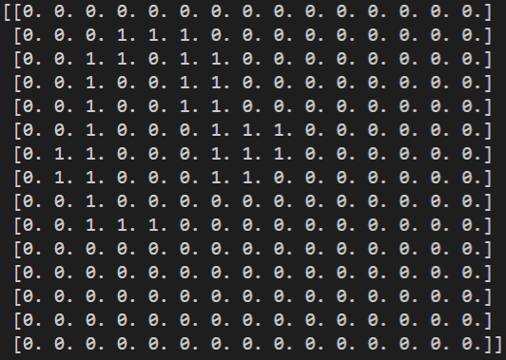
Software Representation

Slide 6
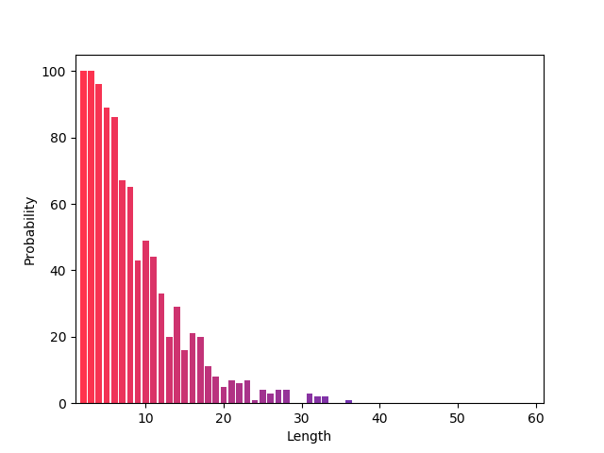
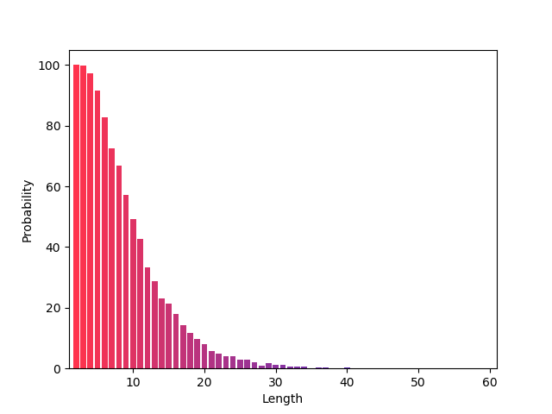
Simple Sampling Method
100 Trials
10000 Trials

Slide 7
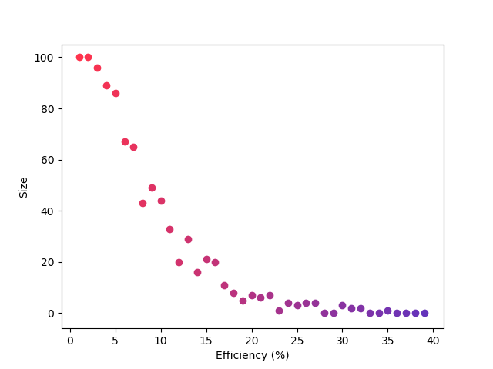
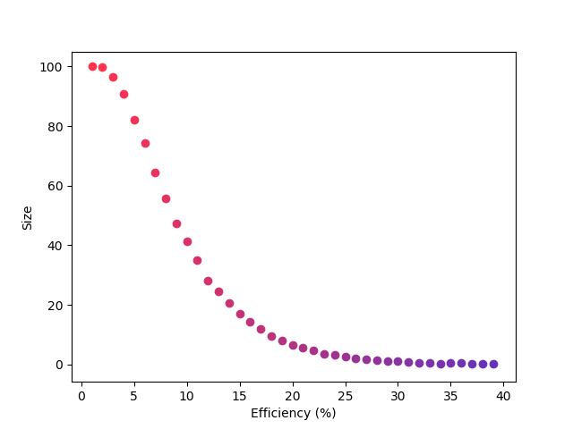
Simple Sampling Method Efficiency
100 Trials
10000 Trials

Slide 8
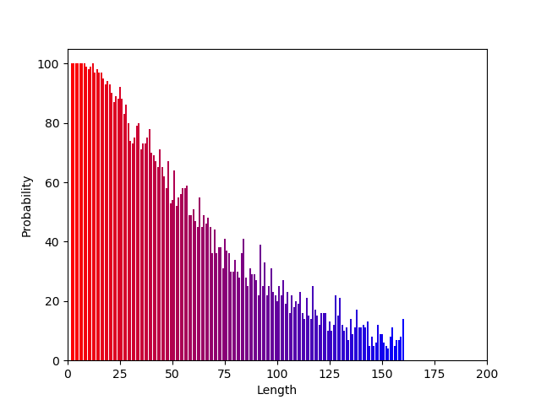
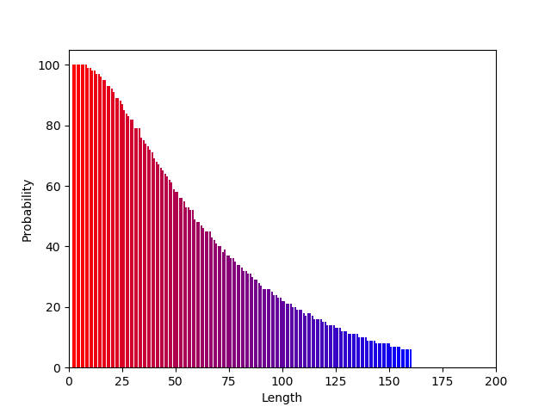
Biased Sampling Method
100 Trials
10000 Trials

Slide 9
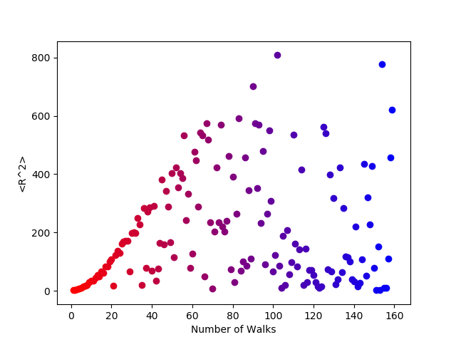
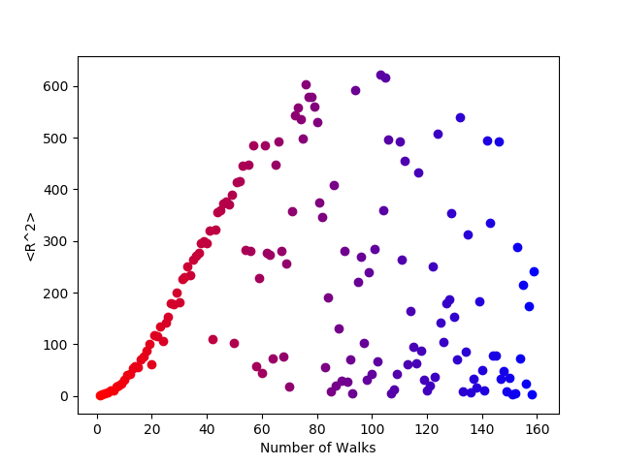
Biased Sampling Method Efficiency
100 Trials
10000 Trials

Slide 10
What Went Wrong?

Slide 11

Weighting Function
Apply the running weight to each successful run
Produces noisy results as N increases
Still working on better representation
$$\prod_{i=1}^{N}{w_{i}}$$

Slide 12
Goal:
https://www.hiskp.uni-bonn.de/uploads/media/polymers.pdf
Recreate the results in the paper using a matrix
Successful with simple methods
Unsuccessful with biased samples

